Slide 1
— Jollpi —
A Lightweight, Simple and Reliable Text Editor
with Python 3, GTK4 and GtkSourceView 5
Zulfian
GNOME Asia Summit 2025 — Tokyo, Japan 14 December 2025

Slide 2
About Me
Python Developer
Linux user since 2008 (with a very long pause)
Creator of Jollpi (2010 → rewrite 2025)

Slide 3
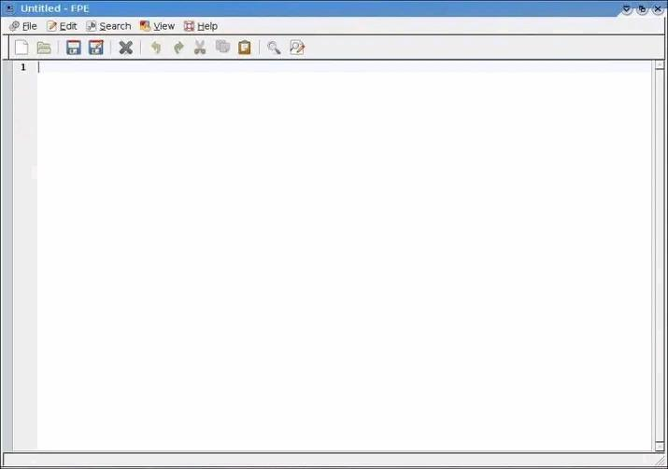
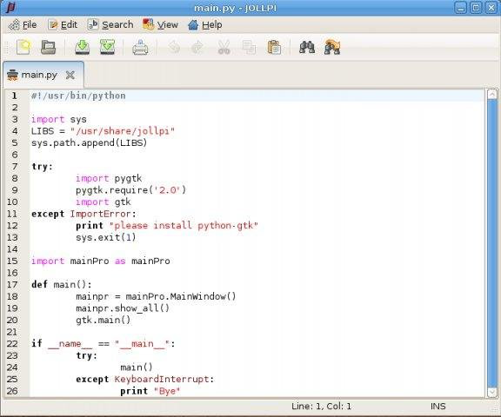
Flashback: Jollpi 2010
First prototype
Last stable release
Python 2 — GTK2 — GtkSourceView 2 — Minimal — Multi-tab
SourceForge: sourceforge.net/projects/jollpi
GitLab: gitlab.com/zulfian1732/jollpi2-legacy

Slide 4
Jollpi 2025 — The Rewrite

Slide 5

Python 2 is end-of-life
GTK4 is a completely different world
GtkSourceView 5 introduces a new approach
User expectations changed
Keep it light and minimal
Why Rewrite ?

Slide 6
Philosophy
Simple and responsive — even with large files
Only core components: Python, GTK4, GtkSourceView5
Maintainable codebase
Typing should feel effortless

Slide 7
Architecture
Python 3
GTK4 (GObject, GDK, GLib)
GtkSourceView 5
Gio File Handling + Monitoring

Slide 8
Async Loading
Uses GtkSourceView.FileLoader
Fully cancellable
UI stays responsive while loading
loader = GtkSource.FileLoader.new(
buffer,
src_file
)
loader.load_async(
priority,
cancellable,
None,
None,
on_loaded,
()
)

Slide 9
Async Search
Async search using SearchContext
Live result count
Replace step-by-step without UI
freezing
ctx = GtkSource.SearchContext.new(
buffer,
GtkSource.SearchSettings()
) ctx.forward_async(
iter,
cancellable,
on_match,
None
)

Slide 10
File Monitoring
Uses Gio.FileMonitor
Detects external modifications
Offers reload / ignore options
gfile = Gio.File.new_for_path(
filepath
)
monitor = gfile.monitor_file(
Gio.FileMonitorFlags.NONE,
None
) # returns Gio.FileMonitor
monitor.connect(
"changed",
on_file_changed
)

Slide 11
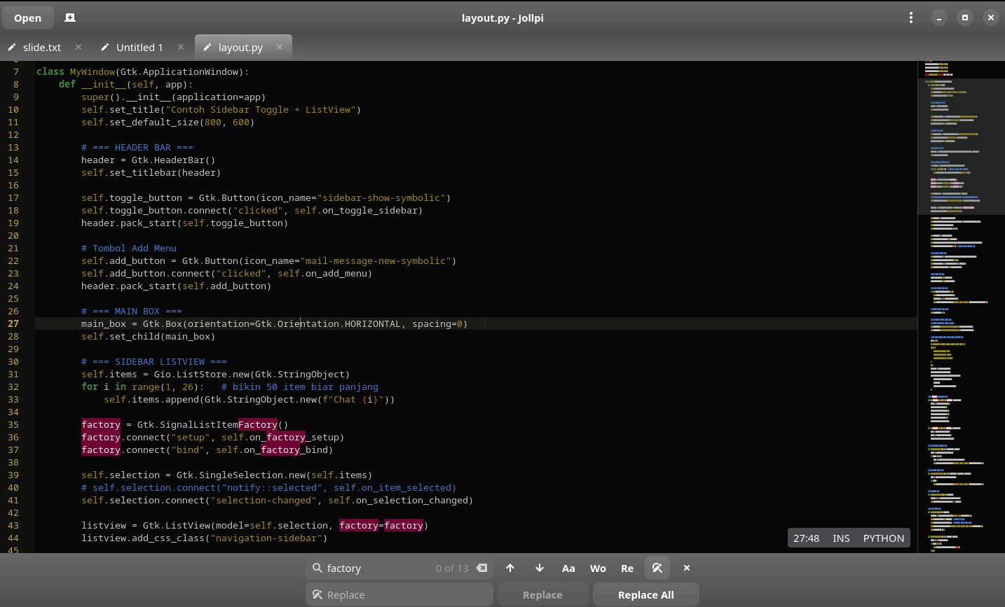
Modern GTK4 UI
HeaderBar
StatusBar Overlay
Search Overlay

Slide 12
Custom Theme
<style-scheme id="jollpi" _name="Jollpi" version="1.0">
<author>Zulfian</author>
<_description>
Just another scheme, which was taken and modified from oblivion style
</_description>
<!-- Palette -->
<color name="butter1" value="#F9ED87"/>
<color name="butter2" value="#9F8E10"/>
<color name="butter3" value="#c4a000"/>
<color name="chameleon1" value="#8ae234"/>
<!-- ......... -->
<!-- Global Settings -->
<style name="selection" background="butter1"/>
<style name="cursor" foreground="aluminium2"/>
<style name="secondary-cursor" foreground="aluminium4-3-blend"/>
<style name="current-line" background="aluminium5"/>
<style name="draw-spaces" foreground="aluminium4"/>
<style name="background-pattern" background="aluminium6-5-blend"/>
Optional custom theme inspired by Oblivion — modified and simplified.

Slide 13
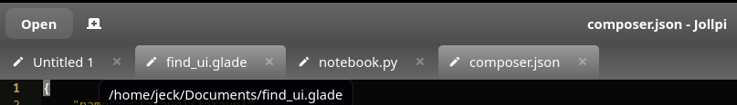
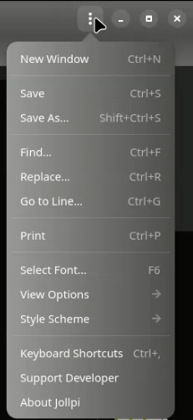
GTK Custom CSS
Custom CSS via Gtk.CssProvider
Consistent look and feel
Lightweight — no extra libraries
provider = gtk.CssProvider()
provider.load_from_file(custom.css)
gtk.StyleContext.add_provider_for_display(
gdk.Display.get_default(),
provider,
gtk.STYLE_PROVIDER_PRIORITY_USER
)

Slide 14
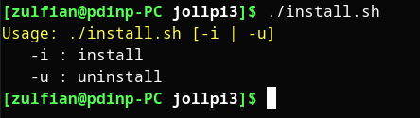
Installer / install.sh
Automated installation
Simple, self-contained script
Handles setup without extra tools

Slide 15
Demo — Jollpi (2025)

Slide 16
From Jollpi to MUN-AI
From Jollpi to MUN-AI
☑ Same toolkit ☑ Same lightweight philosophy ☑ Same maintainability mindset

Slide 17



Jollpi is now public
“Old code isn’t failure.
Sometimes it's just waiting
for a better version of us.”
gitlab.com/zulfian1732/jollpi-text-editor
LinkedIn: ZULFIAN S.Kom
GitLab: @zulfian1732
GitHub: @zulfian1732
Mastodon: @zulfian
E-mail: zulfian1732@gmail.com
Use it. Learn from it
~ Thank You ~

